Slide 1




Excelssior Education Society’s
K. C. College of Engineering & Management Studies & Research
(Affiliated to the University of Mumbai & Approved by AICTE) Mith Bunder Road, Near Hume Pipe, Kopri, Thane (E) – 400603
NAAC Accredited with B++ Grade
For the Degree of Bachelors of Computer Engineering
Academic Year 2023-24
FlowFusion: Pseudocode to Python code with flowchart precision
Sanket Parulekar B-03 (2021016402110992)
Nawazish Patel B-04 (2021016402105503)
Amaan Siddiqui B-21 (2021016402107154)
Raj Tiwari B-35 (2021016402107193)
Guided by :
Prof Keerti Kharatmol
( Assistant Professor )
Department of Computer Engineering
K. C. College of Engineering & Management Studies & Research, Thane (E)

Slide 2

OUTLINE OF PRESENTATION
Introduction
Problem Statement
Aims & Objectives
Literature Survey
Methodology
Hardware & Software Specification
Result & Analysis
Conclusion
Acknowledgement References

Slide 3
INTRODUCTION
What is FlowFusion?
FlowFusion is a tool which,
a. Convert pseudocode into Python code with precision.
b. Simultaneously design flowcharts from pseudocode.
c. Enhance coding efficiency and visual clarity.
d. Streamline development through accurate code generation.

Slide 4
PROBLEM STATEMENT
Developers often face challenges in manually translating pseudocode into Python, which can lead to errors, inefficiency, and lack of clarity. Additionally, creating accurate flowcharts to represent the logic of the code is time-consuming and prone to misinterpretation. The need for a solution that automates both processes—accurately converting pseudocode into Python code and generating precise, visual flowcharts—remains crucial for improving coding precision and enhancing productivity. FlowFusion addresses this by providing an integrated tool that ensures error-free code conversion, coupled with automated flowchart generation, improving overall workflow and code comprehension.

Slide 5
AIM & OBJECTIVES
Aim:
Efficiently converts pseudocode into Python code while simultaneously designing
flowcharts for better visualization, enhancing coding precision and development productivity, and empowering users to code faster and with greater accuracy.
Objectives:
Develop a user-friendly tool for converting pseudocode to Python code.
Generate flowcharts automatically for visual clarity.
Enhance coding accuracy and efficiency for developers by providing seamless integration of pseudocode, code, and flowcharts.

Slide 6
LITERATURE SURVEY
Analysis of current pseudocode-to-code tools reveals a lack of integration with flowchart design and precision.
Literature highlights the need for tools that simplify code generation and visualization for developers.
Building on these insights, we are developing FlowFusion, a platform that seamlessly converts pseudocode to Python code while designing flowcharts for a more streamlined and intuitive coding experience.
For a detailed review, click here

Slide 7
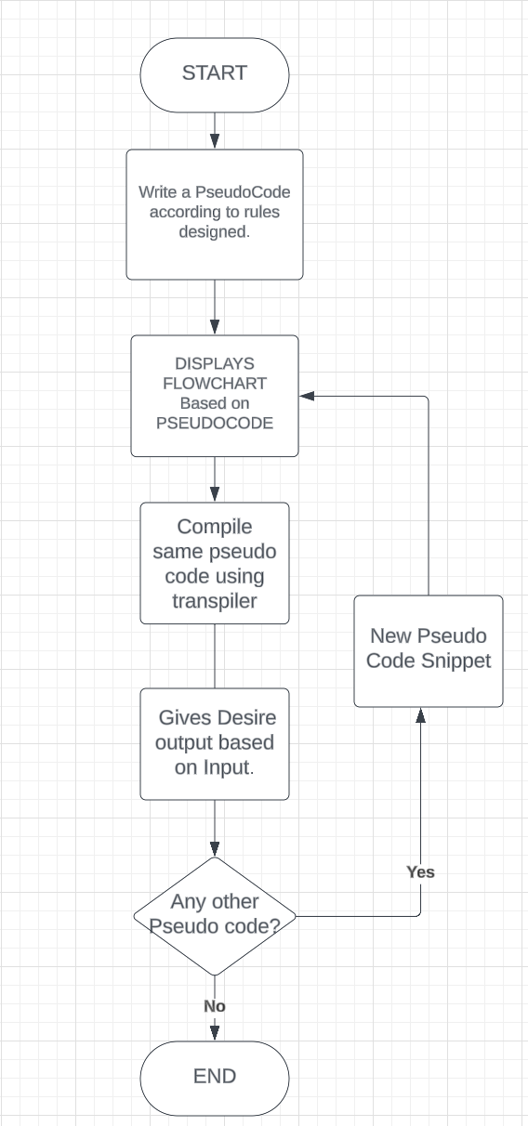
METHODOLOGY
Activity Diagram:

Slide 8
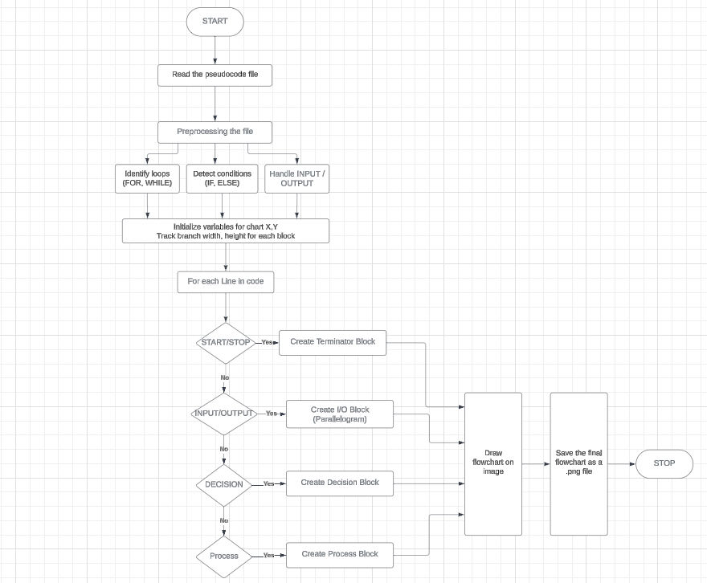
METHODOLOGY
Workflow Diagram for Converting Pseudocode to Flowchart :

Slide 9
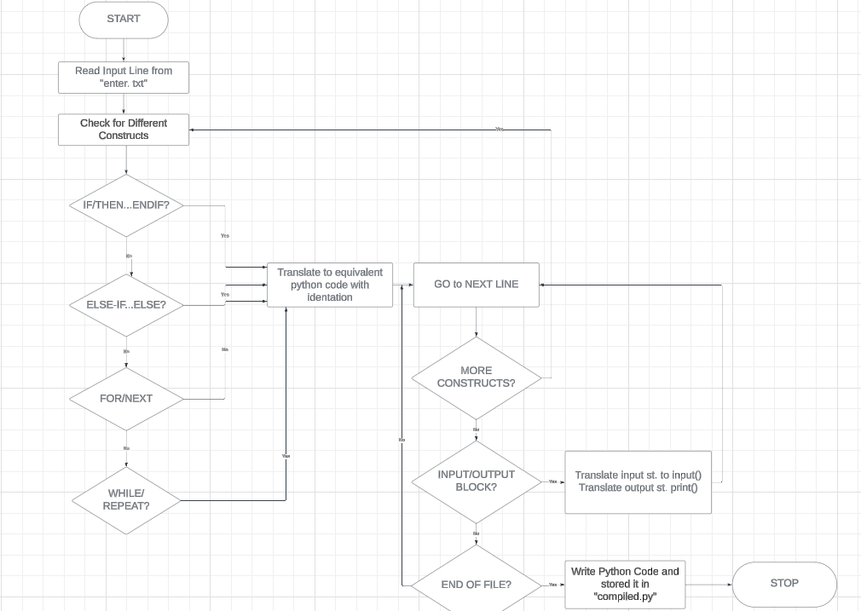
METHODOLOGY
Workflow Diagram for Compiling Pseudocode and Execution:

Slide 10
SOFTWARE & HARDWARE REQUIREMENTS
Programming language used | Python
Technologies used | Data Structures Machine Learning Algorithms for shape classification, Regular Exp. For Compiler design
Editor(software tool) used | Replit (online IDE) for Pseudocode to Flowchart conversion Python IDLE for Pseudocode Compilation

Slide 11
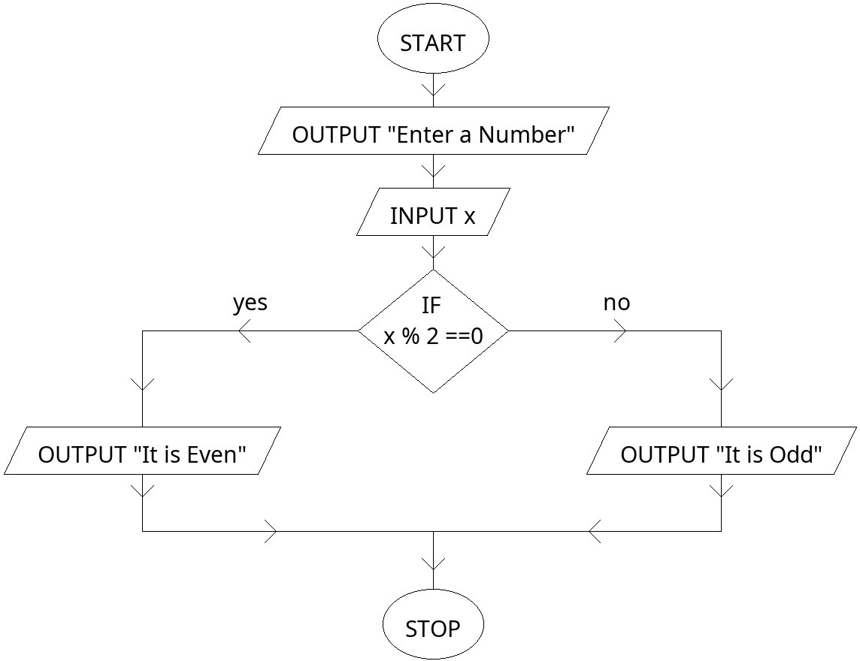
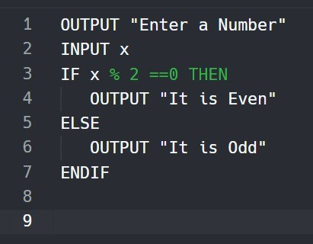
RESULT & ANALYSIS
Output Snapshots of Pseudocode to Flowchart module :

Slide 12
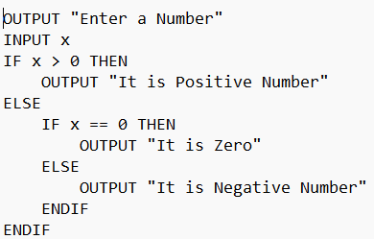


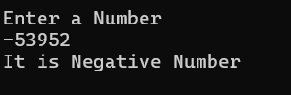
RESULT & ANALYSIS
Output Snapshots of Pseudocode to Python code and Compilation module :

Slide 13
CONCLUSION
In conclusion, the FlowFusion Project emphasizes the importance of efficient coding and visualization in software development.
Our platform provides a user-friendly, precise, and integrated solution for converting pseudocode into Python code while designing flowcharts.
We are committed to making coding more accessible and streamlined for developers.
We invite you to join us as we revolutionize the way coding and flowchart design work together for better productivity.

Slide 14
REFERENCES
Abhay Chopade, Vaibhav Shingade, Aman Chavare, Tejas Bhagwat. "Code Insight - Flowchart Generator." 2024. The project automates pseudocode conversion into flowcharts using OpenAI GPT-3.5 Turbo. DOI: 10.1109/XXXXXXX.
Shreya Shukla, Prajwal Gatti, Yogesh Kumar, Vikash Yadav, Anand Mishra. "Towards Making Flowchart Images Machine Interpretable." 2023. Model: FloCo-T5, a transformer-based framework. DOI: 10.1109/XXXXXXX.
Damitha Karunratna, Nasik Shafeek. "An Extensible Approach to Generate Flowcharts from Source Code." 2018. Language-independent abstract representation. DOI: 10.1109/XXXXXXX.
Xiangyu Zhang, Jianjun Zhao, Haipeng Cai, and Ruoyu Xu. "Automatic Translation from Pseudocode to Source Code: A Machine Learning Approach." 2021. DOI: 10.1109/ICSME52669.2021.9584823.
ikhail Denisov, Anton Anikin, Oleg Sychev. "Dynamic Flowcharts for Enhancing Learners’ Understanding of Control Flow During Programming Learning." 2021. Implementation of a non-editable flowchart widget. DOI: 10.1109/XXXXXXX.

Slide 15
Thank You!!
Any Questions??
FlowFusion

